Slide 1










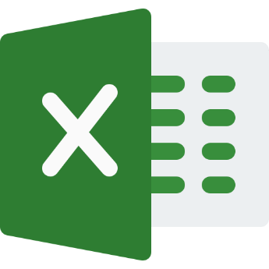




International Crypto Exchanges
Raspberry Pi
Database / File Storage
Python Scripts
Local Crypto Exchanges
WWW
DB Connection
FX Rate Providers
Business Logic / View / Reporting

